Slide 1

SRM INSTITUTE OF SCIENCE AND TECHNOLOGY
SCHOOL OF COMPUTING
DEPARTMENT OF COMPUTING TECHNOLOGIES
18CSP109L- MAJOR PROJECT
AI-Powered Early Diagnosis and Personalized Health Recommendations for Coronary Artery Disease (CAD) Through Predictive Analytics
Project Guide
Name : Dr. M. Revathi
Designation
Assistant Professor Department of Computing Technologies
TEAM :
Student 1(RA2111003010710) Khayati Sharma
Student 2(RA2111003010606) Siddharth Vats

Slide 2
Table of Contents
Abstract
Introduction
Existing System
Literature Review
Problem Statement
Proposed System
Architecture
Objectives
Objectives Achieved
References

Slide 3
Abstract
Heart disease is a leading cause of mortality, making early detection crucial. This project proposes a hybrid ensemble learning model combining SVC, Logistic Regression, and Random Forest to enhance prediction accuracy. A Streamlit-based web application provides a user-friendly interface for input, predictions, and insights. The system follows a microservices-based architecture, integrating data pre-processing, predictive modelling, chatbot for health related queries and health recommendations. By leveraging ensemble learning and health recommendation, this project ensures higher accuracy, transparency, and usability, making it a valuable tool for preventive healthcare.

Slide 4
Introduction
Heart disease is one of the leading causes of death worldwide, making early and accurate detection essential. Traditional diagnostic methods rely on manual interpretation, which can be time-consuming and prone to errors. Machine learning offers a powerful alternative by automating prediction and improving accuracy. This project leverages a hybrid ensemble model, integrating SVC, Logistic Regression, and Random Forest to enhance predictive performance. Additionally, it incorporates a chatbot for health related queries and a health recommendation engine. The system is deployed as an interactive Streamlit-based web application, ensuring ease of use for both medical professionals and individuals seeking early risk assessment.

Slide 5
Existing System
Traditional methods: Manual diagnosis, rule-based medical models
Machine learning models exist but are often:
Single-model based (lack robustness)
Difficult to interpret (black-box nature)
Lacking personalized recommendations

Slide 6
Literature Review
Paper title | Methods Used | Dataset | Key Contributions | Limitations
Machine Learning for Heart Disease Prediction [1] | Supervised ML techniques | Multiple cardiovascular attributes | Demonstrates improved prediction accuracy | No specific limitations mentioned
Heart Disease Prediction Using Machine Learning [2] | Various ML models | Cleveland Heart Disease dataset | Highlights ML's role in early detection | Lacks interpretability and feature importance analysis
Cardiovascular Disease Prediction with ML [3] | Ensemble learning techniques | 70,000+ patient records | Achieves high accuracy using ensemble learning | Does not address model interpretability
Data Mining for Heart Disease Diagnosis [4] | Data mining techniques | Cleveland dataset (UCI) | Enhances diagnostic efficiency | J48 algorithm has performance drawbacks

Slide 7
Problem Statement
Need for a reliable and interpretable heart disease prediction model.
Existing ML models lack hybrid robustness and explainability.
A system is required that:
- Combines multiple models for better accuracy.
- Gives actionable health recommendations based on predictions.
- Clears the patients doubts and queries in real time.

Slide 8
Proposed System
Hybrid Model (Ensemble Learning): Combines SVC, Logistic Regression, and Random Forest.
Data Preprocessing Module: Cleans and prepares data.
Streamlit Web App: User-friendly interface.
Health Recommendation System: Provides actionable advice.
Microservices-Based Architecture: Ensures modularity & scalability.

Slide 9
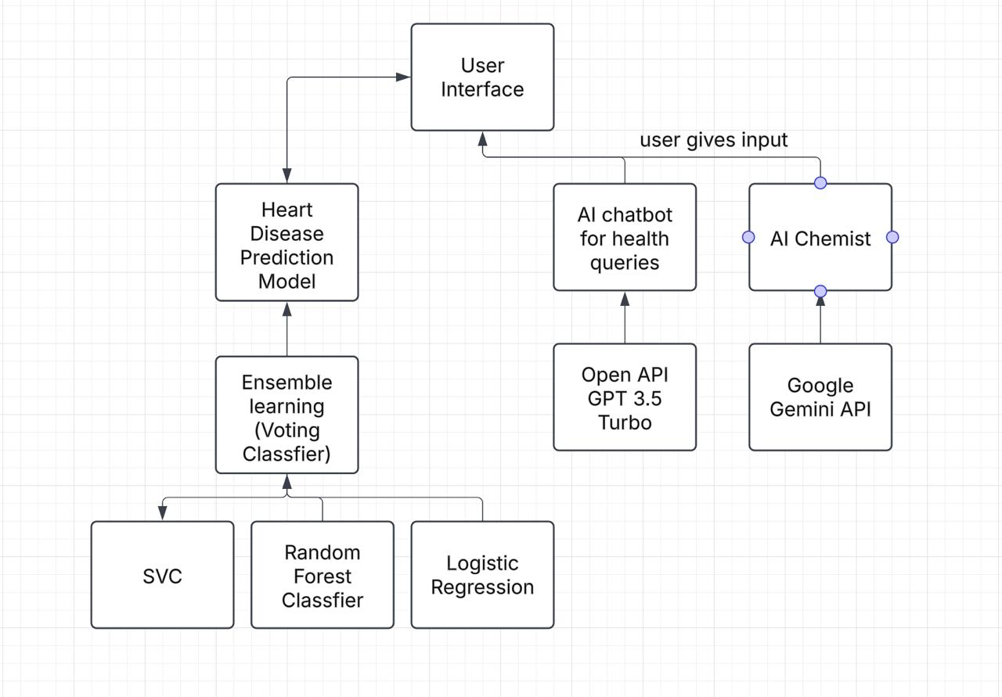
Architecture

Slide 10
Objectives
Combine 3 datasets, i.e, Statlog, Cleveland and Hungary heart disease and do data pre-processing on it.
Improve prediction accuracy by developing a hybrid ensemble learning method combining SVC, Random Forest and Logistic Regression.
Develop a Streamlit-based interactive web app.
Suggest health recommendations based on prediction results.
Integrate a chatbot for answering the user’s health related queries.

Slide 11
Objectives Achieved
Improve prediction accuracy by developing a hybrid ensemble learning method combining SVC, Random Forest and Logistic Regression.
Developed a Streamlit-based interactive web app.
Suggested health recommendations based on prediction results.
Integrated a chatbot for answering the user’s health related queries.

Slide 12
References
[1] Seckeler, M. D., & Hoke, T. R. (2011). The worldwide epidemiology of acute rheumatic fever and rheumatic heart disease. Clinical epidemiology, 67-84.
[2] Gaziano, T. A., Bitton, A., Anand, S., Abrahams-Gessel, S., & Murphy, A. (2010). Growing epidemic of coronary heart disease in low-and middle-income countries. Current problems in cardiology, 35(2), 72-115.
[3] Boukhatem, C., Youssef, H. Y., & Nassif, A. B. (2022, February). Heart disease prediction using machine learning. In 2022 Advances in Science and Engineering Technology International Conferences (ASET) (pp. 1-6). IEEE.
[4] Jindal, H., Agrawal, S., Khera, R., Jain, R., & Nagrath, P. (2021). Heart disease prediction using machine learning algorithms. In IOP conference series: materials science and engineering (Vol. 1022, No. 1, p. 012072). IOP Publishing.
[5] Ramalingam, V. V., Dandapath, A., & Raja, M. K. (2018). Heart disease prediction using machine learning techniques: a survey. International Journal of Engineering & Technology, 7(2.8), 684-687.
[6] Weng, S. F., Reps, J., Kai, J., Garibaldi, J. M., & Qureshi, N. (2017). Can machine-learning improve cardiovascular risk prediction using routine clinical data?. PloS one, 12(4), e0174944.
[7] Fatima, M., & Pasha, M. (2017). Survey of machine learning algorithms for disease diagnostic. Journal of Intelligent Learning Systems and Applications, 9(01), 1-16.

Slide 13
8] Vembandasamy, K., Sasipriya, R., & Deepa, E. (2015). Heart diseases detection using Naive Bayes algorithm. International Journal of Innovative Science, Engineering & Technology, 2(9), 441-444.
[9] Chaurasia, D. V., & Pal, S. (2014). Data mining approach to detect heart diseases. International Journal of Advanced Computer Science and Information Technology (IJACSIT) Vol, 2, 56-66.
[10] Bhatt, C. M., Patel, P., Ghetia, T., & Mazzeo, P. L. (2023). Effective heart disease prediction using machine learning techniques. Algorithms, 16(2), 88.
[11] Patel, J., TejalUpadhyay, D., & Patel, S. (2015). Heart disease prediction using machine learning and data mining technique. Heart Disease, 7(1), 129-137.
[12] Rindhe, B. U., Ahire, N., Patil, R., Gagare, S., & Darade, M. (2021). Heart disease prediction using machine learning. Heart Disease, 5(1).
[13] Tithi, S. R., Aktar, A., Aleem, F., & Chakrabarty, A. (2019, June). ECG data analysis and heart disease prediction using machine learning algorithms. In 2019 IEEE Region 10 Symposium (TENSYMP) (pp. 819-824). IEEE.
[14] Garg, A., Sharma, B., & Khan, R. (2021). Heart disease prediction using machine learning techniques. In IOP Conference series: materials science and engineering (Vol. 1022, No. 1, p. 012046). IOP Publishing.

